Slide 1



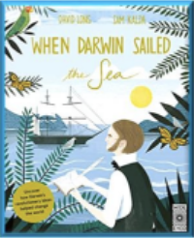
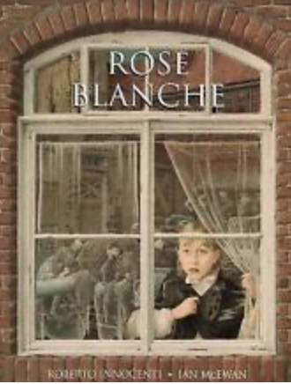
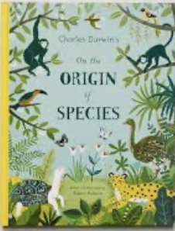
Autumn Term 2024 - Curriculum bulletin
Year 5 & 6 – World at War
Mathematics
English
For Mathematics this term, the children will be covering the topics of place value, addition and subtraction and multiplication ana division and fractions.
In Year 5, the children will be learning to read, write, order ad compare numbers to 1,000,000. They will learn to round numbers within 1 million to the nearest 10, 100 and 1000, They will learn to add and subtract numbers with more that four digits using efficient written methods and will apply these methods when solving multi-step addition and subtraction problems.
For multiplication and division, the children will be calculating factors and multiples. They will learn about prime, square and cube numbers and will learn to multiply a divide a number by 10, 100 and 1000.
The children will learn to find equivalent fractions and how to convert an improper fraction into a mixed number and vice versa to compare fractions. They will learn to add and subtract fractions with the same denominator.
In year 6, e children will be learning to read, write, order ad compare numbers to 10,000,000. They will learn to round any integer to the nearest 10, 100 and 1000. The children will also be learning about negative numbers.
They will learn to multiply a two-digit number by a four-digit number using efficient written methods and will learn to calculate using short and long division. They will apply these methods to solving multi-step problems. The children will also learn the order of operations (known as BIDMAS).
The children will learn how to add and subtract any fraction, including mixed-numbers.
Reading:
For reading, the children will read the book ‘Goodnight Mr. Tom’ by Michelle Magorian. They will also read a range of texts that complement the science topic of ‘evolution;. The children will discuss a range of themes and conventions through these texts. The children will be drawing inferences such as characters'’ feelings and motives as well as discussing words and phrases that capture the reader’s interest and imagination.
Writing:
This term, year 5 + 6 children will be reading the books ‘Rose Blanche’ by Ian McEwan, and ‘Origin of the Species’ by Sabina Radeva. They will use the vehicle texts to inspire writing a diary entry and an explanation text. They will be developing their use of more sophisticated punctuation such as dashes, commas and brackets for parenthesis.
The children will also have the opportunities to write for pleasure to create a memoir and and explanation text linked to an area of personal interest.

Slide 2
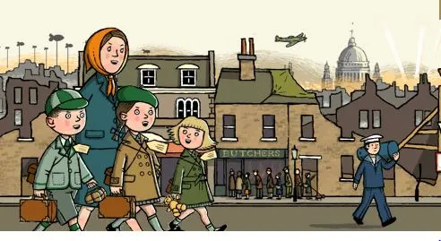
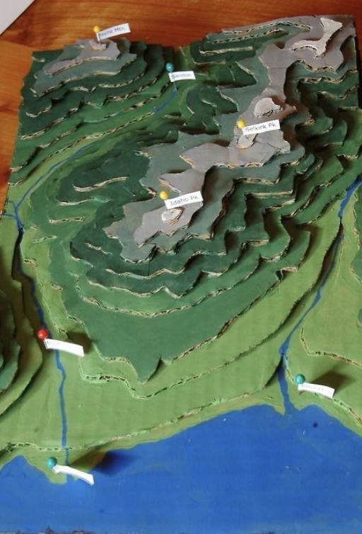
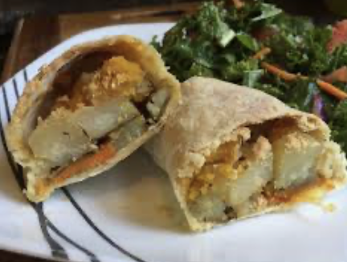
The Big Picture – World at War
Autumn Term 24 - Curriculum bulletin
History – World War 2
Geography – Europe
For history, the children will be learning about the World War 2. They will learn about the countries and leaders involved in both sides of the conflict. They will explore causes and consequences of World War 2.
The children will also explore how life on the home front changed during the war, including the blitz, evacuation, rationing and digging for victory.
For geography, the children will be learning about the continent of Europe. They will learn to use 6-fgure grid references to locate countries and cities in Europe.
They will explore a range of different maps including physical maps and political maps including exploring how political maps changed during WW2.
The children will explore physical and characteristics of Europe including climate, rivers and mountains, fjords, glaciers and lakes and will locate some of the famous landmarks across Europe.
They will compare two contrasting region of Europe –the Apls and the Mediterranean. They will learn about reasons for tourists visiting these areas and the impact they have on the economy, environment and people.
Design and Technology – War time Vegetable Turnover
For design and technology, the children will be learning about the seasonality of vegetables. They will explore existing pastry products and evaluate in terms of appearance, nutritional value and taste. The children will then design and make their own vegetable turnovers. They will seek consumer feedback from their peers to evaluate their products.
Art – 3D Topography
For art, the children will combine several art skills such as collage, painting and line drawing to create a topographical map of a country or region in Europe.

Slide 3
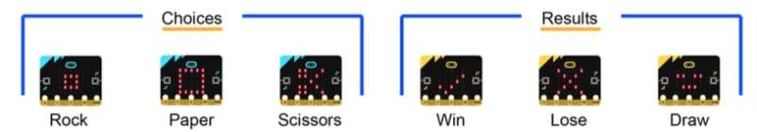
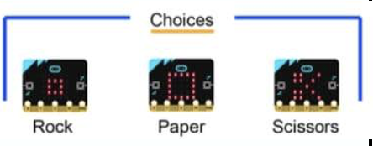

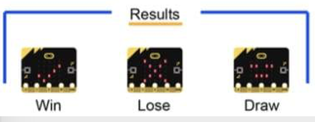
Autumn Term 2023-24 - Curriculum bulletin
Computing – Programming Games
For computing, the children will be exploring the concept of variables when programming games using the BBC micro:bit. They will learn what variables are and relate them to real-world examples pf values that can be set and changed. They will use variables to create a game of rock, paper, scissors. They will test the game to look for ‘bugs’ in the algorithm and will improve their game by de-bugging.
Music
For music, the children will explore the importance of wartime songs for motivating troops during WW1 and WW2. They will compare wartime songs from each time period in terms of pace, rhythm, dynamics and lyrics and the reasons for these different styles.
Physical Education
For P.E. this term, the children will be practicing skills across the sports of tag rugby, football, gymnastics and netball.
They will practice and develop key skills for each sport, including passing, moving, marking and shooting. The children will also develop attacking and defending principles while gaining a greater understanding of the tactical side through game related practice..
Religious Education
For RE this term, the children will be exploring the questions: ‘Creation and Science: conflicting or complementary?’ And ‘Was Jesus the Messiah?’
The children will learn that Christians believe that God created the universe and that here is much debate around the relationship between the accounts of creation in Genesis and contemporary scientific accounts. The children will learn that there are many scientists, throughout history and now, who are Christians.
The children will also learn that the Old Testament talks about a 'rescuer' – a messiah. Some texts talk about what this 'messiah' would be like. Christians believe that Jesus fulfilled these expectations, and that he is the Messiah.
PSHE
For PSHE this term, the children will be learning about Keeping Safe. They will learn about the different kinds of contact, including unwanted constant, which could also be bullying.
They will learn about the importance of seeking help from a trusted adult if they find physical; or emotional contact uncomfortable, or if they feel unsafe about anything.

Slide 4
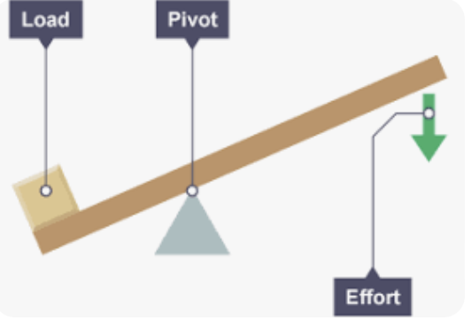
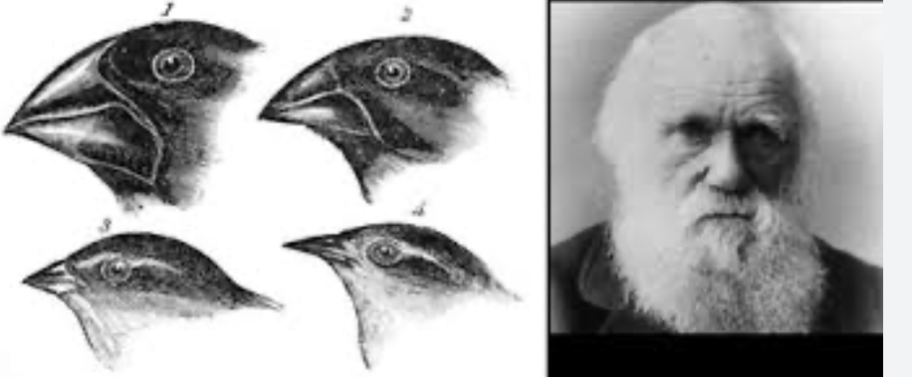
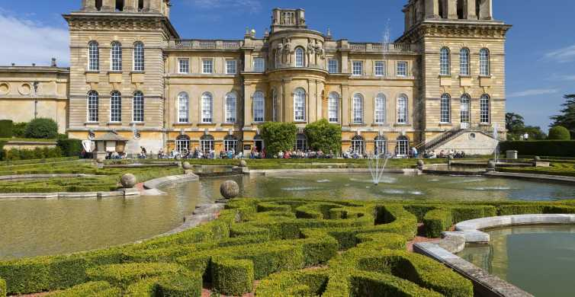
Autumn Term 2023-24 - Curriculum bulletin
In the second half of the term the children will study the topic ‘Evolution and Inheritance’ In this topic, they will recognise that living things have changed over time and that fossils provide information about living things that inhabited the Earth millions of years ago. They will recognise that living things produce offspring of the same kind but that offspring may vary and are not identical to their parents.
They will identify how animals and plants are adapted to suit their environment in different ways and that adaptation may lead to evolution.
Science
For the first half of the term, the children will be completing the science unit ‘forces’. During this unit, they will learn that unsupported objects fall to the Earth ‘s because of the force of gravity and that gravitational force is equal on all objects. The children will investigate the the effects of air resistance between surfaces. They children will explore some mechanisms, in particular to learn that levers allow for a smaller force to have a greater effect and the possible uses of levers.
Trips and enrichment
This term, we will be taking the children to Blenheim Palace – the home of Winston Churchill. Here they will explore the stunning grounds and take part in a mission, where they must investigate clues to find out what life was like at Blenheim Palace during world war 2.

