Slide 1
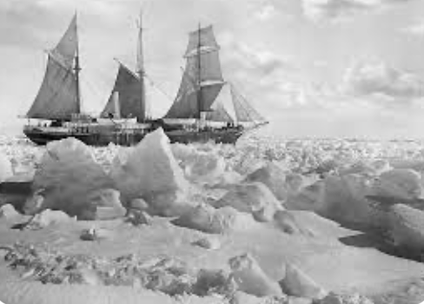
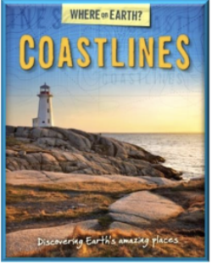
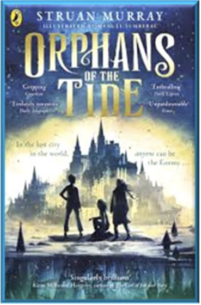
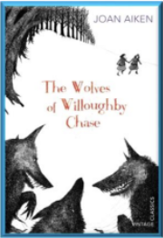


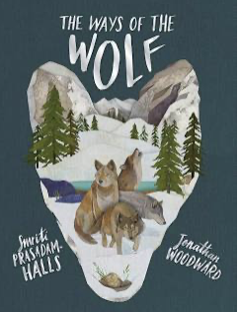
Spring Term 2023-24 - Curriculum bulletin
Year 5 & 6 – Shackleton's Journey
Mathematics
English
For Mathematics this term, the children will cover the topics of fractions; decimals; area and perimeter; algebra and statistics.
In year 5, the children will consolidate their leaning of multiplication and division to solve a wide range of problems. They will learn to multiply a fraction by an integer and to find the fraction of a number. The children will practise identifying the value of digits in a number including decimals and will learn to multiply and divide a number by 10, 100 and 1000.
For shape, space and statistics, the children will learn to calculate the area of a rectangle and of compound shapes. They will learn how to draw and read line graphs and how to read and interpret two-way tables.
In year 6, the children will learn the symbol for ratio and how it relates to their learning of fractions. They will learn how to use ratio to solve problems involving recipes and to draw scale drawings.
For algebra, the children will learn how to form a simple expression and how to solve simple equations with two unknown values.
The children will learn how to compare and order fractions, decimals and percentages. They will learn how to multiply and divide any number by 10, 100 and 1000. The children will also learn how to find the percentage of an amount.
For shape, space and statistics, the children will learn how to find the area of a triangle and of a parallelogram. They will learn how to find the volume by counting cubes.
The children will learn how to read and interpret line graphs and pie charts and how to calculate the mean as an average.
Reading:
As part of our ’Steps to Read’ programme the children will be reading a range of texts on the theme of ‘coasts’ as well as a range of heritage plays and poetry. The books will support the children to develop their word reading and comprehension skills as well as to increase their knowledge of a wider range of texts and themes.
Writing:
This term, year 5 and 6 children will be reading the books ‘Shackleton's Journey’ by William Grill, and ‘The Ways of the Wolf’ by Smriti Prasadam Halls. The children will use the texts to write across a range of genres including narratives, magazine articles and balanced arguments. They will be developing their use of more sophisticated punctuation such as dashes, commas and brackets for parenthesis.

Slide 2
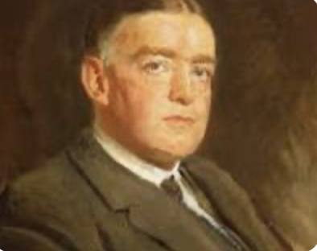
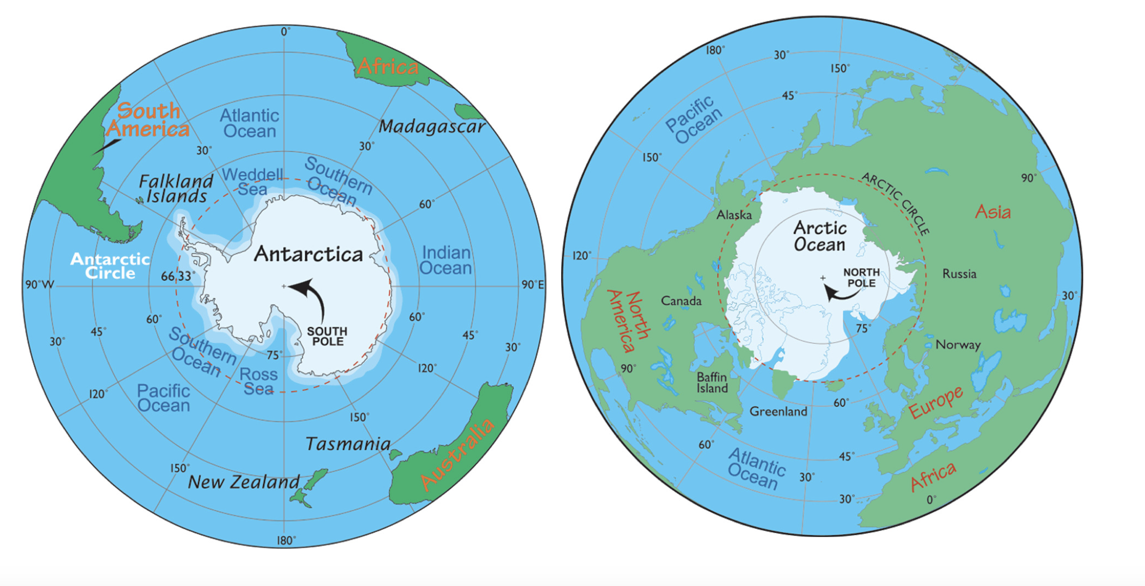
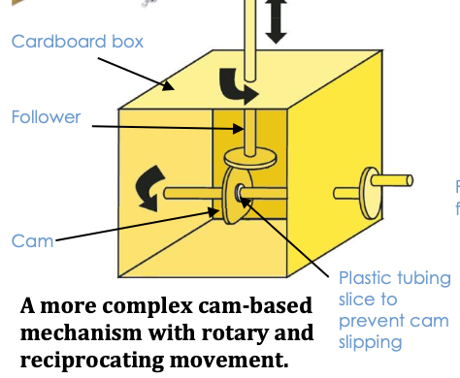
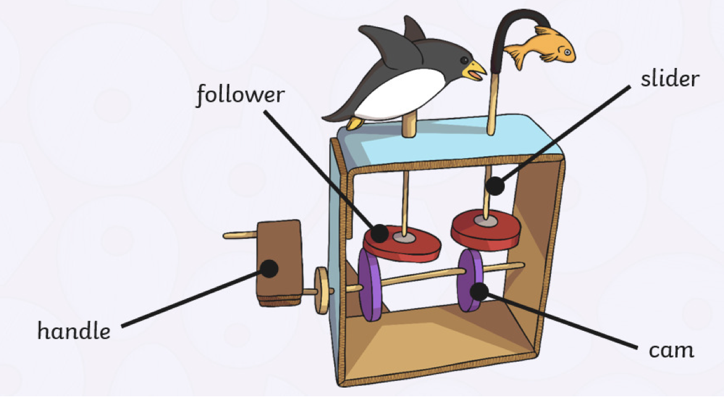
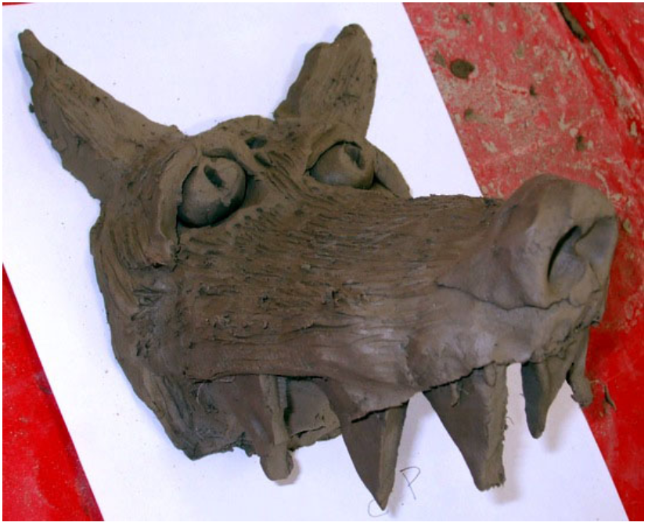
The Big Picture – Shackleton's Journey
Spring Term 2023-24 - Curriculum bulletin
History – Earnest Shackleton
Geography – The Polar Regions
For geography, the children will learn to locate and label Antarctica, the Arctic ocean, seas and countries using an atlas. They will compare the climate zone of Antarctica, the Arctic Tundra and the UK. The children will learn human and physical features of Antarctica including the permafrost, glaciers, Mount Vinson, research stations and Inuit settlements. They will explore the weather extremes of the regions and using computer technology to plot graphs that represent these.
For history, the children will be learning about the famous explorer and sailor Earnest Shackleton. They will learn about the early 20th century’s race to reach the South Pole. They will learn how, in 1911, Shackleton, alongside Captain Scott, set of on a mission to be the first to reach the South Pole. The children will learn about the challenges the team faced on this mission including freezing conditions, and the rivalry with fellow explorer Roald Amundsen.
Computing
For computing, the children will learn how to use a spreadsheet (Excel) to input and interpret data. The children will develop an understanding of the structure of a spreadsheet. They will begin to use formulas to produce calculated data. They will understand that the type of data in a cell is important (e.g. numbers can be used in calculations whereas words cannot). The children will learn how to create graphs of their data and use the results to answer questions.
Design and Technology – CAM mechanism
For D & T, the children will be exploring toys with moving parts. They will explore how different types of movement can be made using cam mechanisms. The children will then use their knowledge to design, make and evaluate their own Antarctic themed moving toy.
Art - Clay
For art, the children will be exploring the processes of rolling out clay; forming a shape around a simple armature (newspaper); modelling, cutting joining and applying texture to the clay to create a wolf sculpture.

Slide 3
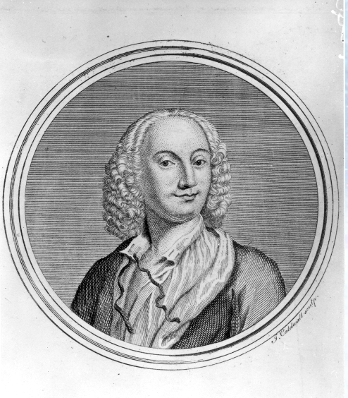
Spring Term 2023-24 - Curriculum bulletin
Physical Education
Music
For P.E. this term, the children will be practising skills across the sports of, basketball, hockey and tennis.
They will practise and develop key skills for each sport including, passing, moving, marking and shooting. The children will also develop attacking and defending principles while gaining a greater understanding of the tactical side through game related practice.
The children will also be exploring the 4 elements of dance: space, time, shape and energy. They will work to develop a whole class dance to showcase at our annual dance extravaganza,
For music, the children will be listening and responding to music by the famous Italian composer Antonio Vivaldi. They will listen to and reflect on a piece of orchestral music, and will focus on Vivaldi’s ‘Winter’ (one the pieces from Vivaldi’s Four Seasons violin concerti)
They children will learn musical language to describe the pieces that they hear. They will create their own piece of music using instruments and voice and perform their piece as an ensemble.
PSHE
For PSHE this term, we will be exploring the topics of respectful relationships and caring friendships.
The children will learn about the importance of respecting others, even when they are very different from themselves. They will learn that most friendships have ups and downs, and that these can often be worked through so that the friendship is repaired or even strengthened, and that resorting to violence is never right. They will learn practical steps they can take to improve respectful relationships.
The children will learn about the importance of self-respect and how this links to their own happiness. They will explore different types of bullying (including cyberbullying), the impact of bullying, and how to get help for yourself or others. The children learn what a stereotype is, and how stereotypes can be unfair, negative or destructive.
Religious Education
For RE this term, the children will be learning about Islam. They will explore the question: Why is it important to Muslims that Muhammed is known as the seal of the prophets? In this unit, the children will explore the significance of prophethood in Islam. They will consider the similarities and differences between the Abrahamic faiths and the division of Islam into Sunni and Shi’a.
After half term, the children will focus on the Christian celebration of Easter. They will explore the question: What do Christians believe about the death of Jesus?

Slide 4
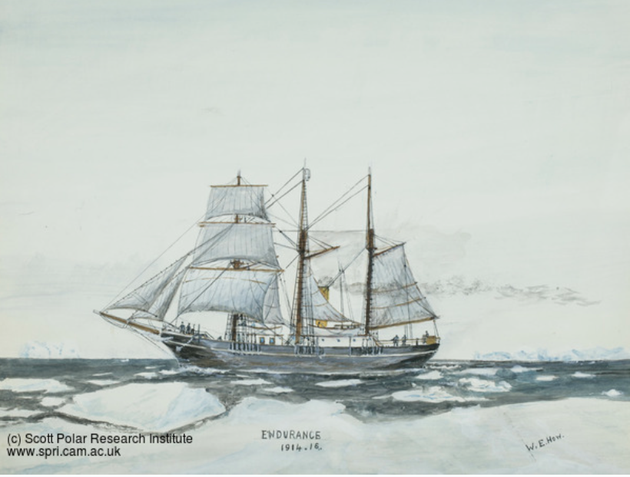
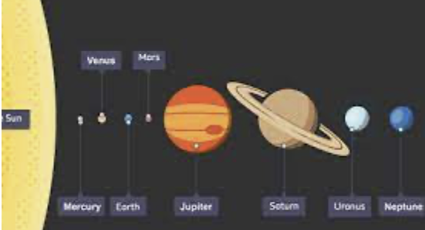
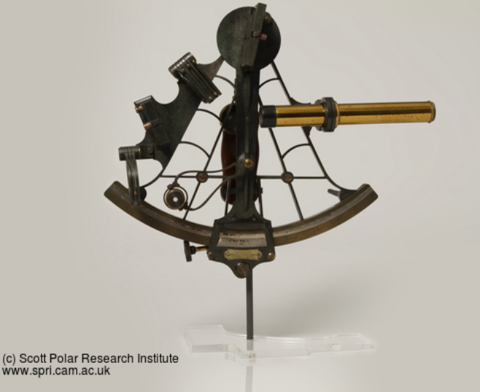
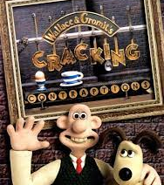
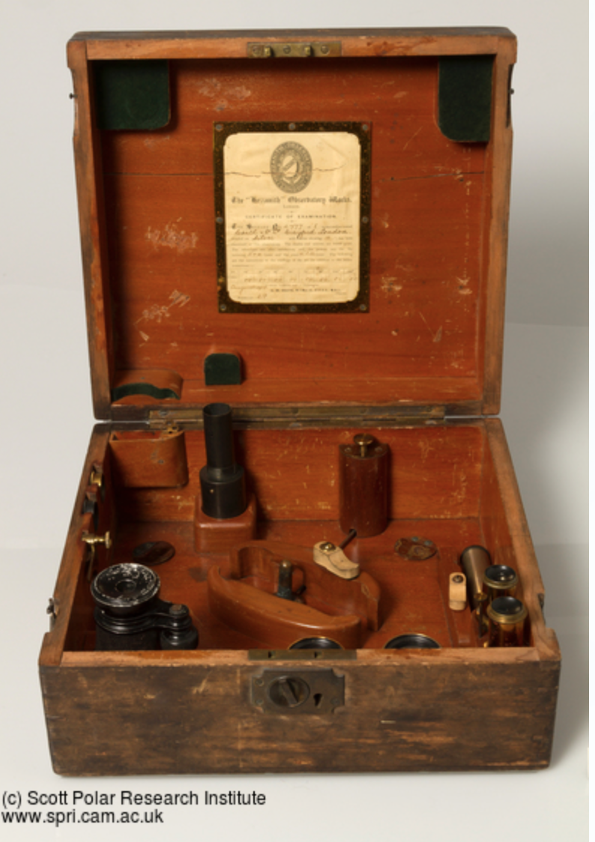
Spring Term 2023-24 - Curriculum bulletin
Trips and enrichment
Science
This term, the children will be completing the science unit ‘Earth and Space’. During this unit, the children will learn to describe the movement of the Earth and other planets, relative to the Sun in the solar system. They will also describe the movement of the Moon relative to the Earth and how this explains the moon cycle. The children will explore the idea of the Earth’s rotation to explain day and night and the apparent movement of the Sun across the sky.
We have some exciting enrichment opportunities linked to this topic, the details of which we will share next term.
This term, year 5 and 6 will take part in an online workshop hosted by the Scott Polar Research Institute.
The session will last for around 60 minutes and will include opportunities for children to have a closer, privileged look at objects from the collections. They will hear a real-life story of exploration, illustrated with items from the collection and the children will have the opportunity to ask questions.
STEM week
This term, we will be holding a STEM week themed around Wallace and Gromit’s cracking contraptions. The children will be researching products to explore how they work and will create their own ‘cracking contraptions’ to solve a problem for Wallace and Gromit.
The children will also learn about the process of stop-motion animation. They will create their own characters to produce their own short, stop-motion cartoon.

