Slide 1





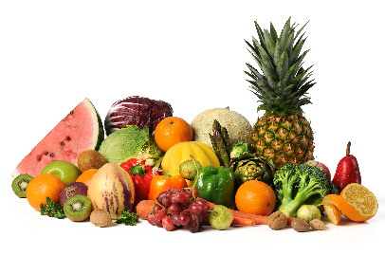

MENU 01:
Served weeks commencing 13th April, 04th May, 25th May, 15^{thj} June, 06th July
Vegetarian Halal
Monday | Tuesday | Wednesday | Thursday | Friday
Jacket Potato with Filling | Chicken Tikka Or Beef Chilli | Roast Chicken Or Roast Pork | BBQ Chicken Pizza | Fishcakes
Macaroni Cheese | Vegetable Dhal | Quorn Sausages | Margarita Pizza | Cheese and Onion Pasties
Baked Beans | Rice | Roast Potato |  | Oven Chips
Cheese/Tuna/Coleslaw Salad Bar White or Brown Rolls | Peas Salad Bar Naan Bread | Green Beans Salad Bar White or Brown Rolls | Sweetcorn Salad Bar Garlic Bread | Baked Beans Salad Bar White or Brown Rolls
Gingerbread Man | Raspberry Jelly | Soreen Bar | Vanilla Ice-cream | Chocolate Chip Muffins
Fresh bread is offered daily
Fresh fruit or yoghurt also offered as an alternative dessert
All menu items are subject to availability
Do you think you are Free School Meal eligible?
Please contact your school office for more information on how to apply.

Slide 2


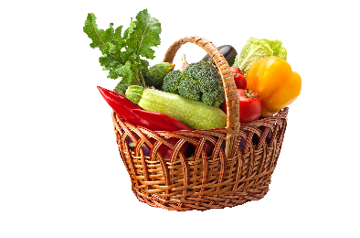


MENU 02:
Served weeks commencing 20th April, 11th May, 01st June, 22nd June, 06th July
Vegetarian Halal
Monday | Tuesday | Wednesday | Thursday | Friday
Jacket Potato with Fillings | Beef Bolognese Or Pork Meatballs | Roast Chicken Or Roast Turkey | Chicken Burger Or Pork Hotdog | Breaded Fish
Cheese and Tuna Pasta Bake | Cauliflower & Broccoli Cheese Bake | Macaroni Cheese | Vegetable Burger | Vegetable Samosa
Baked Beans | Penne Pasta | New potatoes | Oven Chips | Wedges
Cheese/Tuna/Coleslaw Salad Bar White or Brown Rolls | Peas Salad Bar Garlic Bread | Vegetables Medley Salad Bar White or Brown Rolls | Sweetcorn Salad Bar | Spaghetti Hoops Salad Bar White or Brown Rolls
Pineapple and Cream | Strawberry Jelly | Homemade Cookies | Mixed Yoghurts | Jam Doughnuts
Fresh bread is Offered daily /
Fresh fruit or yoghurt also offered as an alternative dessert /
All Menu items are subject to availability
Do you think you are Free School Meal eligible?
Please contact your school office for more information on how to apply.

Slide 3
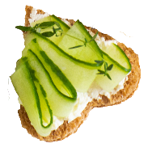

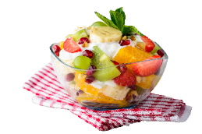


MENU 03:
Served weeks commencing 27th April, 18th May, 15th June, 08th June, 29th June, 20th July.
Vegetarian Halal
Monday | Tuesday | Wednesday | Thursday | Friday
Jacket Potato With Filling | Beef Cottage Pie Or Chicken Goujons with Wedges | Chicken Sausages Or Pork Sausages | BBQ Chicken Pizza | Fish Fingers With Ketchup
Tomato and Basil Pasta Bake with Cheese | Chinese Vegetable Noodles | Vegetables Pastie | Margarita Pizza | Quorn Hotdogs
Baked Beans |  | Herby Potato | Garlic Bread | Oven Chips
Cheese/Tuna/Coleslaw Salad Bar White or Brown Rolls | Carrots Salad Bar White or Brown Rolls | Green Beans Salad Bar White and Brown Rolls | Salad Bar | Peas Salad Bar White or Brown Rolls
Mixed Yoghurt | Chocolate Ice-Cream | Orange Jelly | Blueberry Muffin | Oreos Biscuits
Do you think you are Free School Meal eligible?
Please contact your school office for more information on how to apply.

