Slide 1

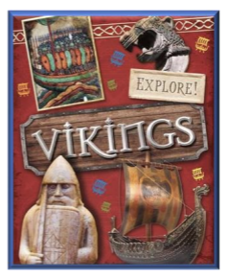
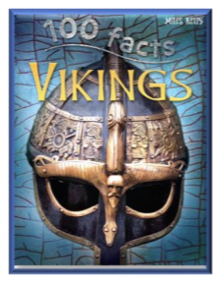
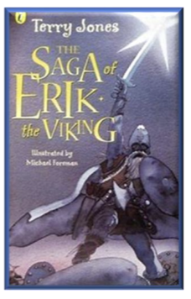
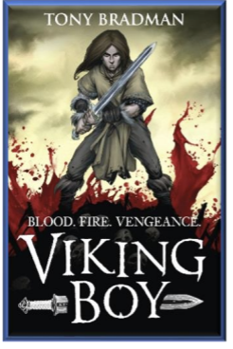
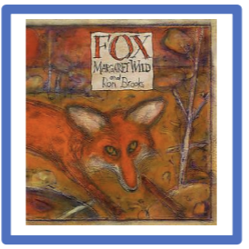
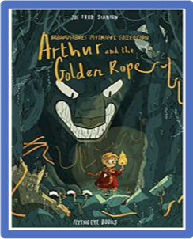
Autumn Term 2025-26 - Curriculum bulletin
Year 3 & 4 – Vicious Vikings
Mathematics
English
For Mathematics this term, the children will be covering the topics of place value, addition and subtraction, and multiplication and division.
In Year 3, the children will be learning to read, write and partition numbers to 1000. They will be able to say what is 1, 10, 100 and 1000 more or less than any given number to 1000. They will learn to round numbers to the nearest 10, 100 or 1000. They will be learning to add a two-digit number to a three-digit number using formal written methods. For multiplication and division, the children will be focusing on the 2,3,4 and 8 times tables and their associated division facts.
In year 4, the children will be learning to read, write and partition numbers to 10,000. They will be able to say what is 1, 10, 100 and 1000 more or less than any given number to 10,000. They will learn to round numbers to the nearest 10, 100 or 1000 and will also learn that, in roman numerals, L represents 50 and C represents 100. They will be learning to add and subtract two four-digit numbers using formal written methods. For multiplication and division, the children will be focusing on the 6,7,9,11 and 12 times tables and their associated division facts. The children will be calculating the area of a shape by counting squares.
Reading:
As part of our ’Steps to Read’ programme, the children will be reading a range of texts linked to their non-core theme ‘Vicious Vikings’. The books will support the children to develop their word reading and comprehension skills across fiction, poetry and non-fiction.
Writing:
As part of our ‘Read to Write’ programme, the children will be reading the books ‘Fox’ by Margaret Wild and Ron Brooks, and ‘Arthur and the Golden Rope’ by Joe Todd-Stanton. They will use the vehicle texts to plan and write a fable narrative; an information report about foxes; a myth narrative; and an information guide on how to defeat a Viking monster.
They will be learning how to organise paragraphs around a theme and how to use conjunctions to express time and cause. They will also learn to correctly punctuate speech using inverted commas.

Slide 2
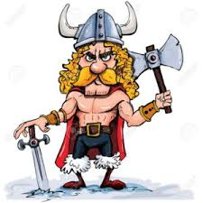
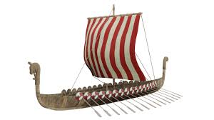
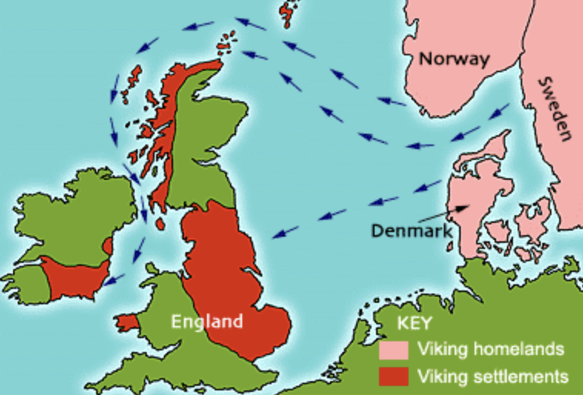
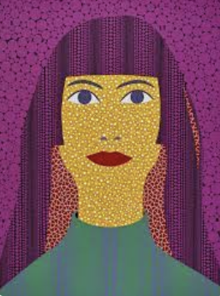
The Big Picture – Vicious Vikings
Autumn Term 2025-26 - Curriculum bulletin
History – Vicious Vikings
Design and Technology – Viking Longship
For History, the children will be learning about the Vikings. They will consider why the Vikings came to Britain; what resistance they met and what impact they left in the UK and within our local area. They will learn about what the Vikings were like as people, and how they lived their lives.
For design and technology, the children will be exploring Viking longships. They will be considering the design features of the ships, as well as materials and processes that would have been used to build them. The children will consider the limitations of the design and recommend improvements. They will then design and make their own improved modern longships.
Geography – Viking Settlements
For Geography, the children will learn about the Viking homelands in Scandinavia (Norway, Sweden and Denmark). They will explore human and physical features of these places and the climate.
The children will develop their map work skills by locating countries that the Vikings visited and settled and how they navigated from place to place. They will find out where the Vikings settled in the UK, focussing on our local area and finding evidence for this in place names.
Art - Portraits
For Art, the children will be learning about the famous artist Yayoi Kasuma, particularly focusing on her use of pattern. They will be learning to work with increasing control and precision when painting detail, lines and edges of shapes. They will learn that colour has both light and dark values and will experiment with mixing these. They will learn about the colour wheel and how to use complimentary colours for effect. The children will apply these skills to create their own self-portraits in the style of Yayoi Kasuma.

Slide 3
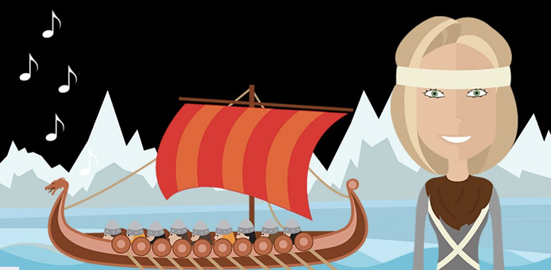
Autumn Term 2025-26 - Curriculum bulletin
Music
Computing
For music, the children will be listening to and singing Viking Saga Songs. These songs are music inspired by the gods and goddesses of Viking mythology. The songs explore the atmosphere and excitement of the Viking world while being rooted in familiar modern styles, such as reggae, rock and lyrical ballads. The songs link closely with learning through the Viking topic, helping them to explore this history theme through music.
For computing, the children will learn to recognise different parts of a school or office network e.g. server, switch, router, client, and WIFI point. They will learn to use a wider range of search operators to efficiently find information in a search engine
The children will learn that information put online leaves a digital footprint and how to use technology safely, respectfully and responsibly. The children will identify trusted adults that they should go to to raise concerns about content or contact that they come across online.
Physical Education
For P.E. this term, the children will be practising skills across the sports of tag rugby, football, gymnastics and netball.
The children will learn the basic rules of the different sports whilst playing in competitive games. Children will understand what skills are needed during a game and will start developing tactical awareness.
RE
For RE this term, the children will be exploring the questions: 'How are different people inspired by the teachings of Jesus?' and 'Does art help with understanding stories?'
Through these questions, the children will make connections between some of Jesus’ teachings and the way Christians live today.
They will present their own ideas about the most important attitudes and values to have today, making links with our school Christian values.
PSHE
For PSHE this term, the children will be learning about keeping safe. They will learn about the different kinds of contact, including unwanted contact, which could also be bullying.
They will learn about the importance of seeking help from a trusted adult if they find physical or emotional contact uncomfortable, or if they feel unsafe about anything.

Slide 4
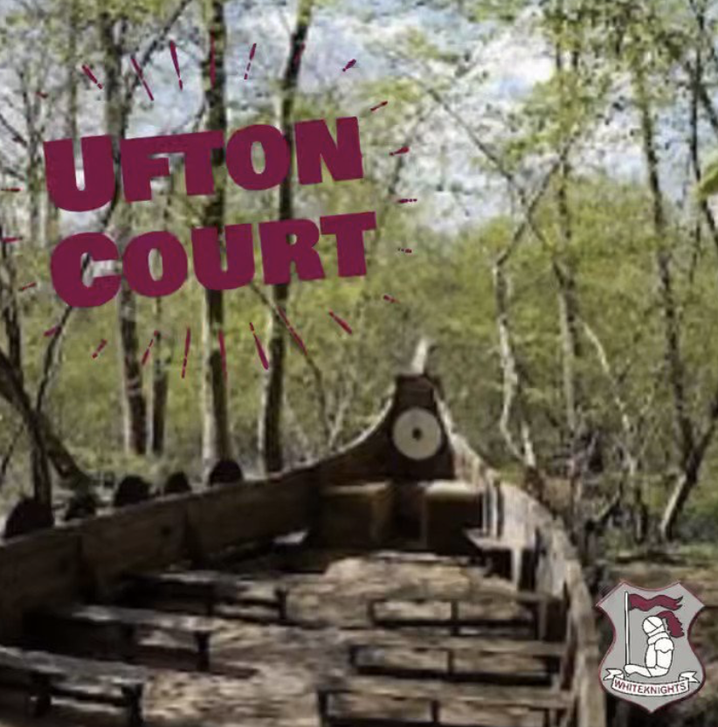
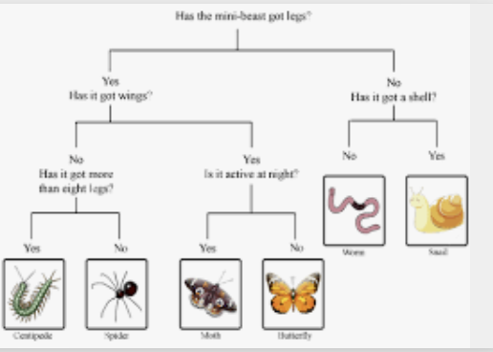
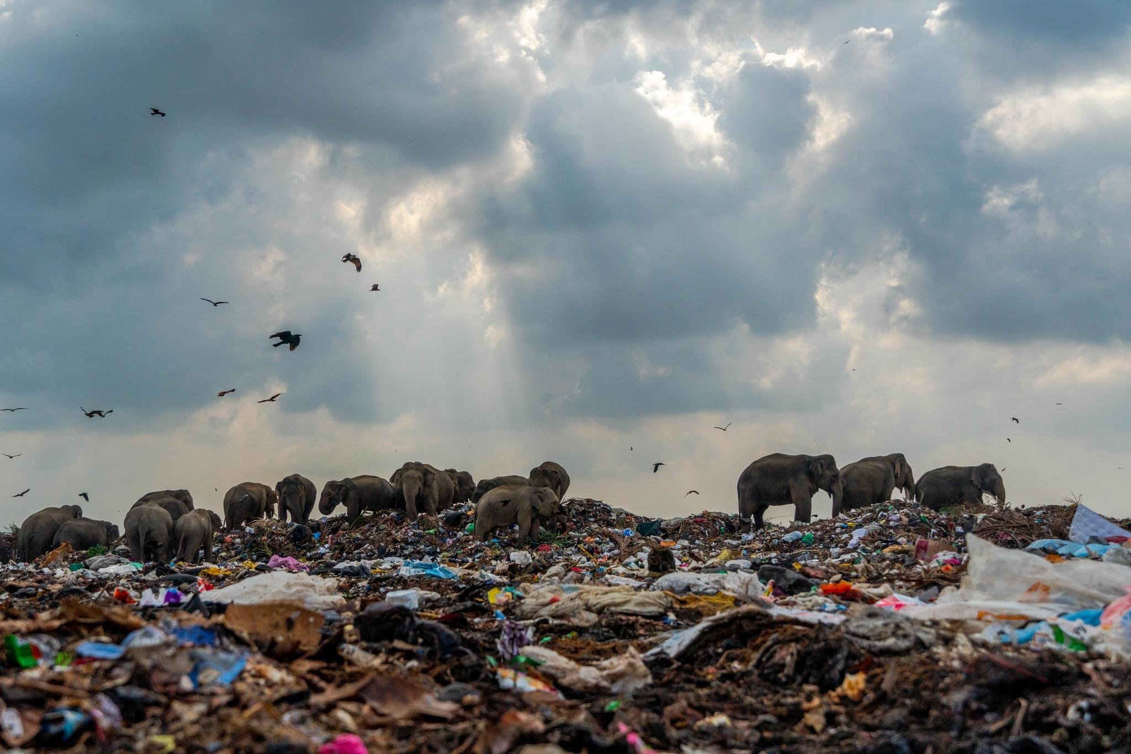
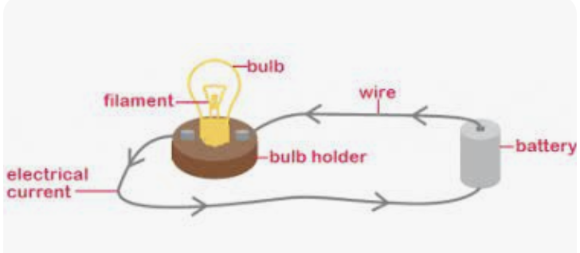
Autumn Term 2025-26 - Curriculum bulletin
Trips and enrichment
Science
This term, the children will be visiting Ufton Court to take part in a Viking day experience.
Home to woodlands, longboats and campfires, this inspiring outdoor learning environment will be the perfect place for our year 3 and 4 pupils to immerse themselves in this exciting history topic.
For Science this term, the children will be exploring the topics of habitats and electricity. They will learn about the requirements of life, including, movement, respiration, sensitivity, growth, excretion, reproduction and nutrition. They will learn about how living things are divided into broad groups (reptiles, amphibians, mammals, fish and birds) and the characteristics of each. They will create branching keys to identify living things.
For electricity, the children will practise making simple electrical circuits. They will learn the correct scientific vocabulary for each part of the circuit, including, cell, component and switch. They will learn that a circuit must be complete to work. They will learn about electrical conductors and test different materials to find out if they are conductors or insulators and will use this knowledge to design a switch for a circuit.
RE and Art week
This Autumn term, we will be holding an RE and Art themed week based around the question: Do animals belong to God?
The children will hear about the part that animals play in our lives. They will hear from people of a range of different faiths to find out about the different beliefs about animals. The children will learn how to paint a portrait of a chosen animal and will consider the impact that human activity has on the lives of animals.

